Slide 1

Milestone 7 Technical Design
February 14th, 2020

Slide 2
Agenda
Team & Client Introduction
Input Design
Output Design
Additional Processes
Physical Architecture
Closing Remarks
User Interface

Slide 3
Team & Client Introduction
ITI Solutions
Edenbridge Family Services
Notes:
Aidan

Slide 4
Our Team
ITI Solutions
Aidan C. | Team Leader & Database Designer
Harley L. | Liaison Officer & Programmer
Justin A. | Database Developer
Beryon C. | Server Engineer & User Experience
Evan G. | Programmer & User Experience
Notes:
Everyone

Slide 5

Our client
Organization that provides services for individuals that require special assistance
Government funded/ privately funded organization
Notes:
Aidan

Slide 6
Current system
Edenbridge's current system is paper based with Excel spreadsheets and accounting software
This system has them entering & manipulating 200+ employees' timesheets manually
Notes:
Aidan

Slide 7
Current system problems
It is easy for the coordinators to book workers for overtime because shifts are spread across multiple binders/departments
When shifts are rescheduled it can cause errors in time tracking
The process of entering timecards into Excel is time consuming
Notes:
Aidan

Slide 8
Project description
We are making a scheduling and time-tracking web application for Edenbridge.
Employees will be able to log in through an online portal for different options
Coordinators will be able to schedule workers, workers will be able to view their schedules
Notes:
Aidan

Slide 9
Project description
Two interconnected parts:
Scheduling
Time tracking
Notes:
Aidan

Slide 10
Input Design
Electronic Forms
Input Screens
Notes:
Aidan

Slide 11
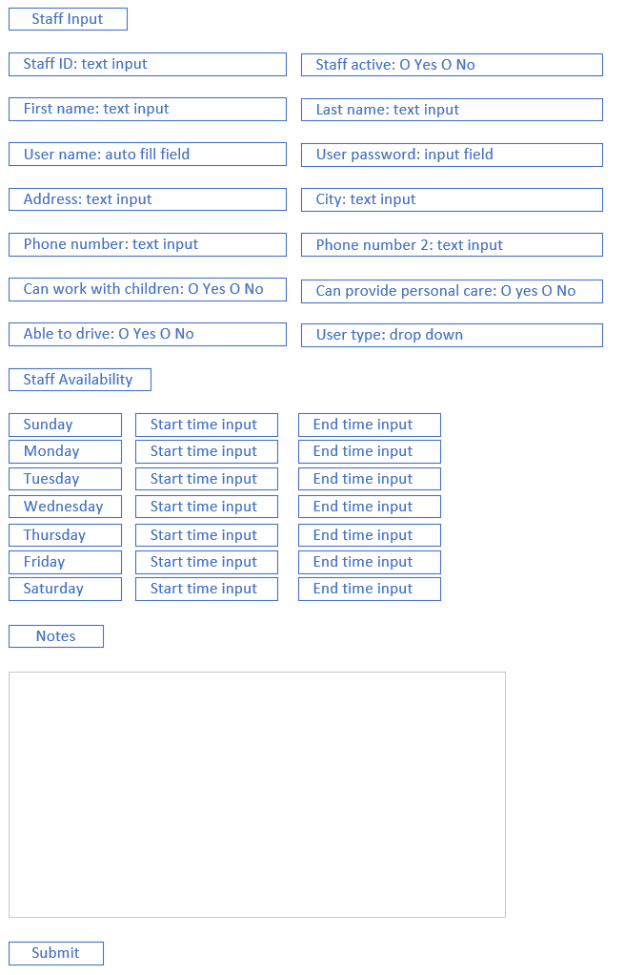
Staff input
This form will let admins input new staff into the system
Notes:
Aidan

Slide 12
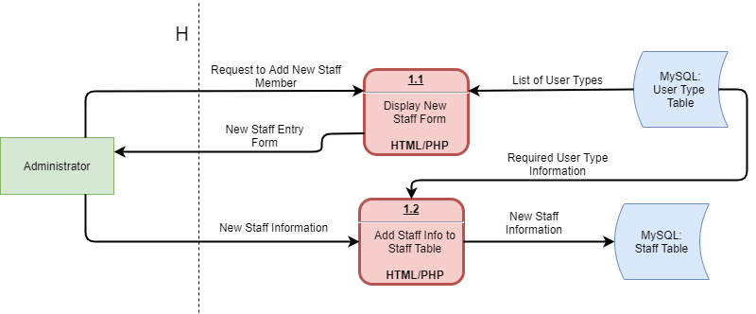
Staff input
Notes:
Aidan

Slide 13
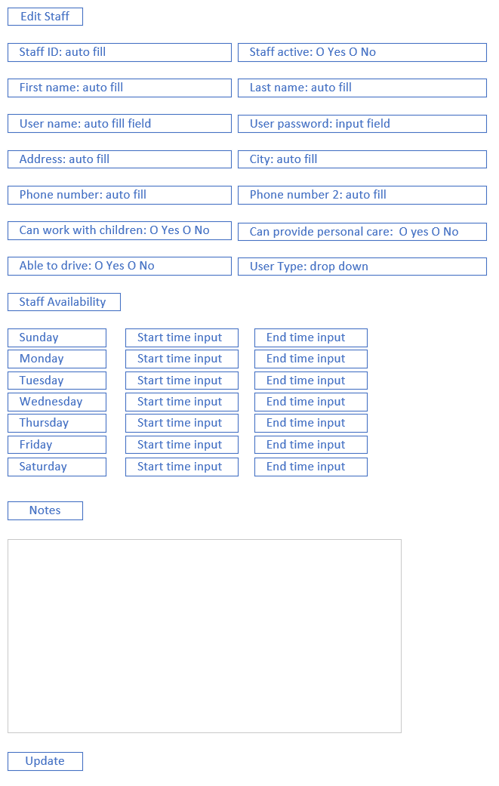
edit staff
Admins will use this to update staff that are already in the system
All the fields will auto fill and let the admin change what is needed
Notes:
Aidan

Slide 14
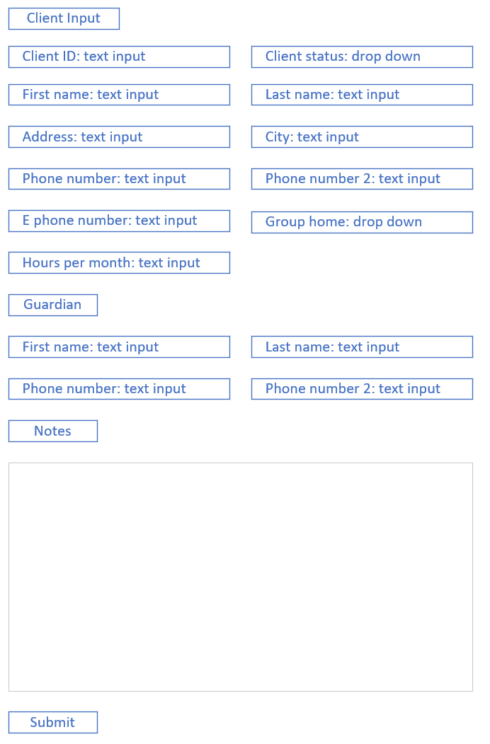
Client input
Admins will use this form to add new clients into the system
Notes:
Aidan

Slide 15
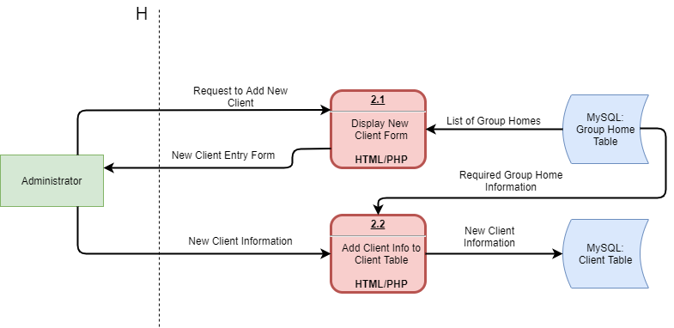
Client input
Notes:
Aidan

Slide 16
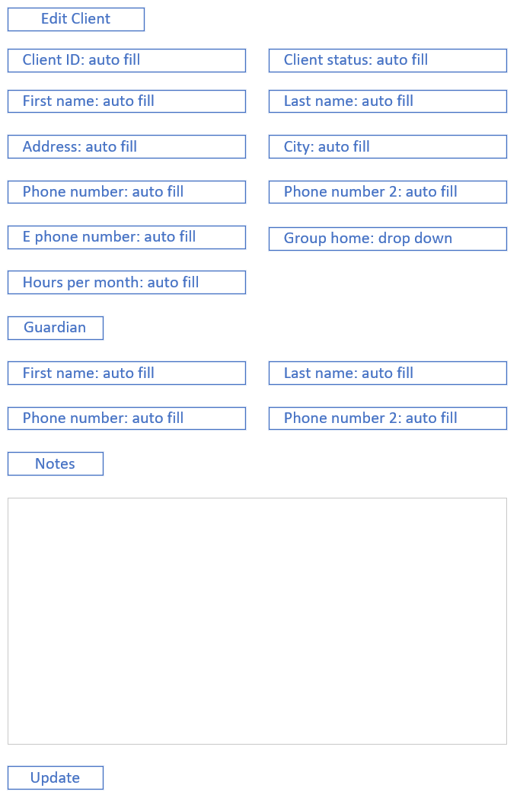
edit client
Admins will use this to update clients that are already in the system
All the fields will auto fill and let the admin change what is needed
Notes:
Aidan

Slide 17
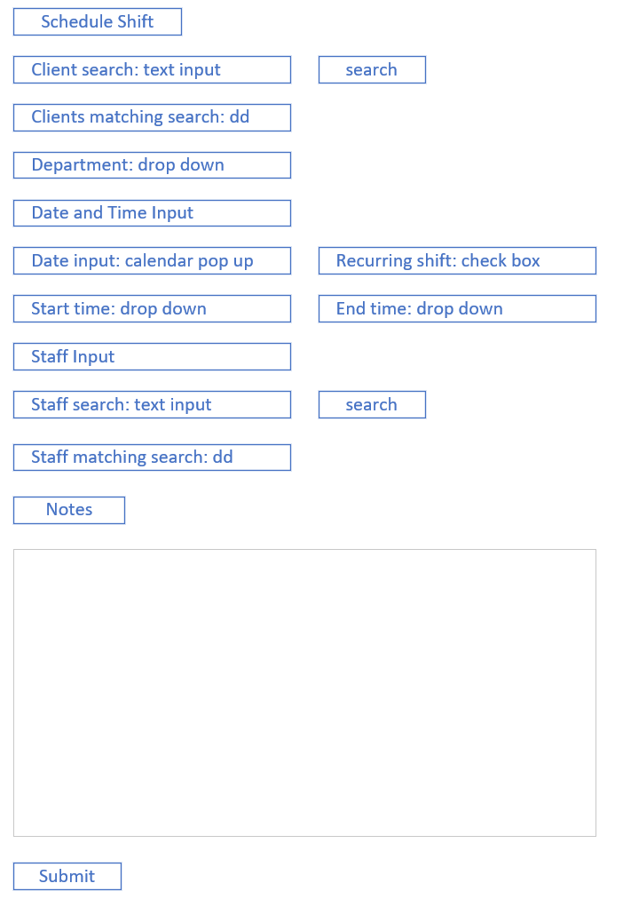
Schedule shift
This is the main form coordinators will use to book both recurring shifts and individual shifts
Notes:
Justin

Slide 18
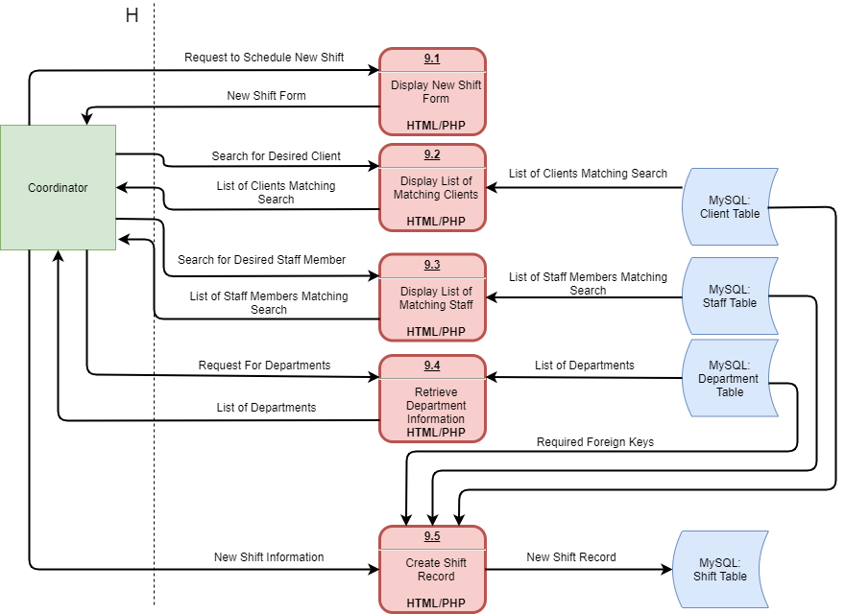
Schedule shift
Notes:
Justin

Slide 19
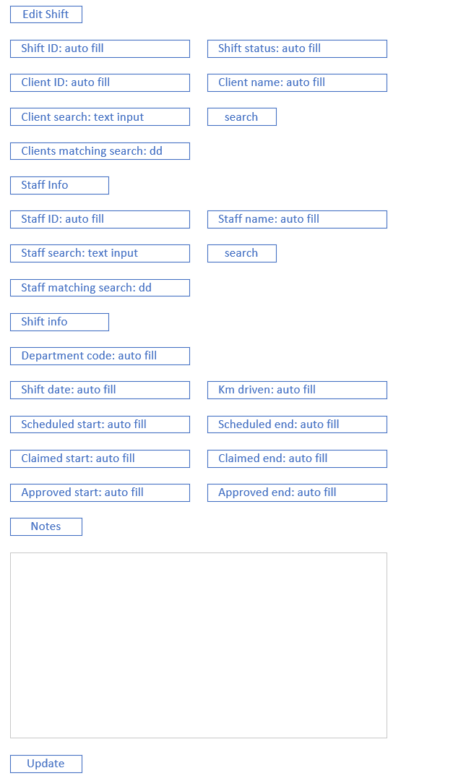
edit shift
Admins and coordinators will use this to update shifts that are already in the system
All the fields will auto fill and let the admin change what is needed
Notes:
Justin

Slide 20
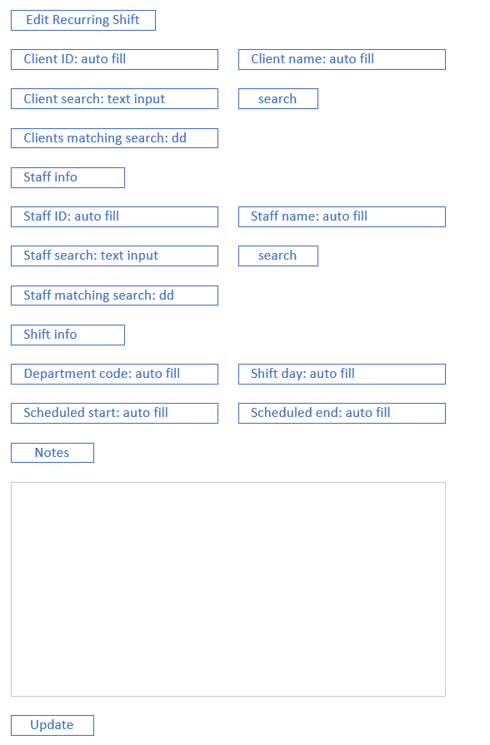
edit recurring shift
Admins and coordinators will use this to update recurring shifts that are already in the system
All the fields will auto fill and let the admin or coordinator change what is needed
Notes:
Justin

Slide 21
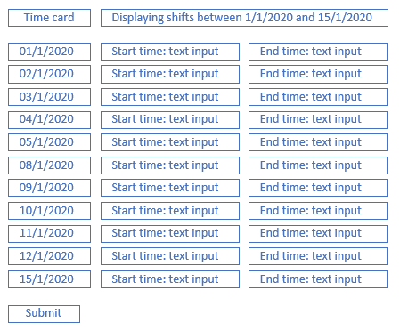
Timecard submission
Workers will use this form to input their hours
This form will only show dates that the worker was scheduled
The form will also auto fill the start and end times allowing the worker to quickly submit their hours and make minor changes if they worked longer than what was scheduled
Notes:
Justin

Slide 22
Output Design
Reports
Screens
Formatting
Notes:
Justin

Slide 23
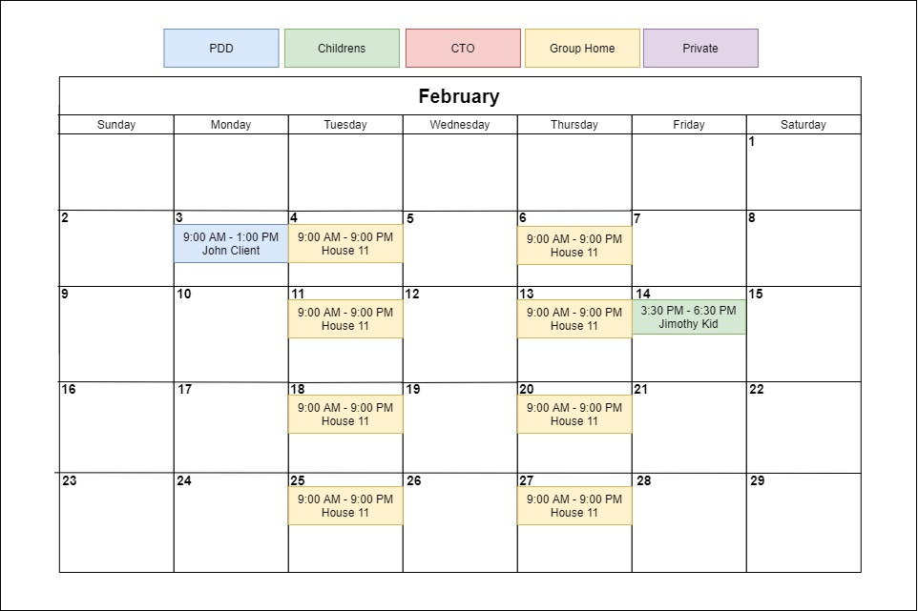
Staff calendar
Notes:
Justin

Slide 24
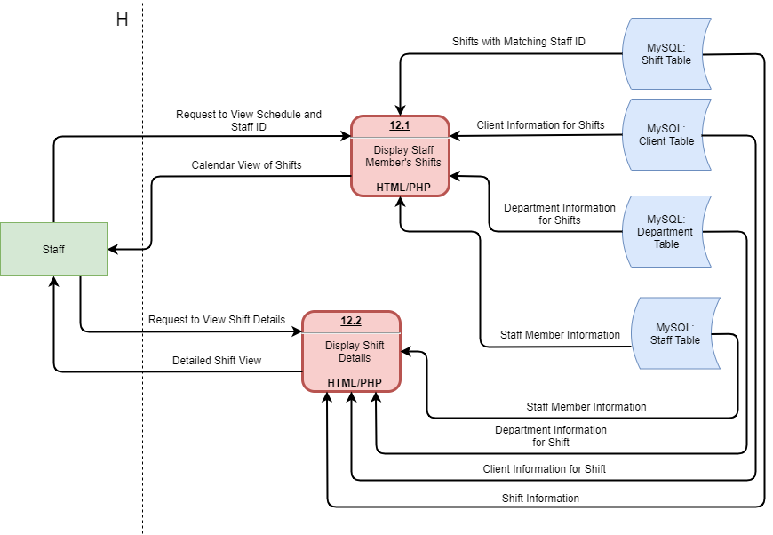
View shifts
Notes:
Justin

Slide 25
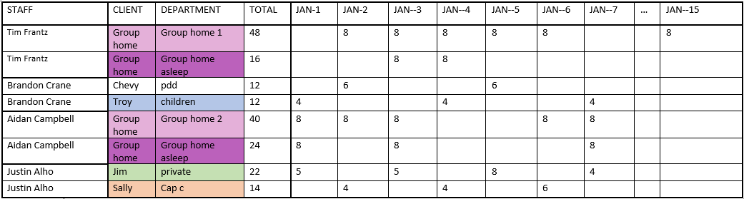
Time Tracking output
Notes:
Justin

Slide 26
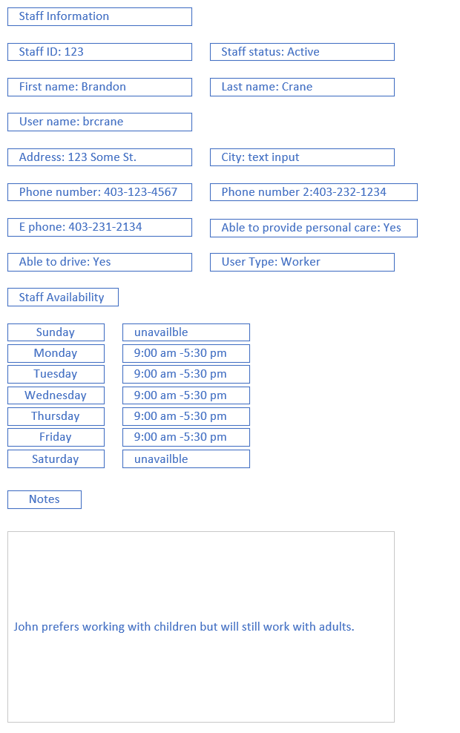
View staff
information
Notes:
Justin

Slide 27
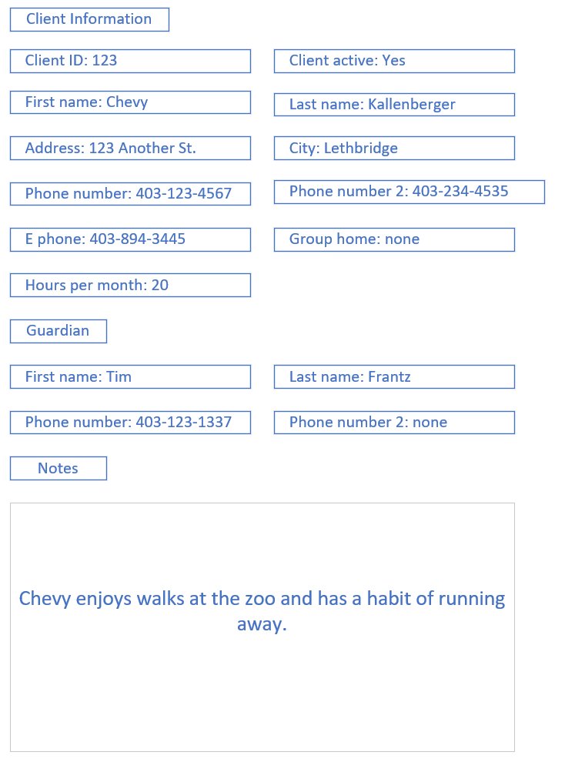
View client
information
Notes:
Justin

Slide 28
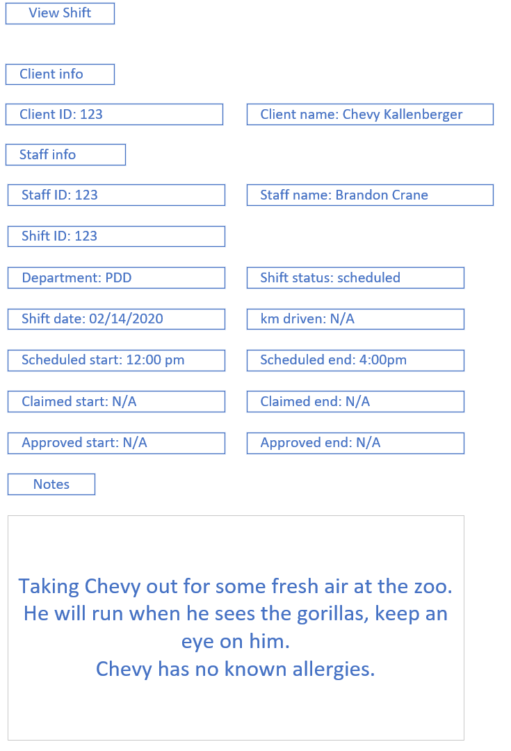
View shift
information
Notes:
Justin

Slide 29
Additional Processes
Backup & Restoration Processes
Help Functionality
Notes:
Harley

Slide 30
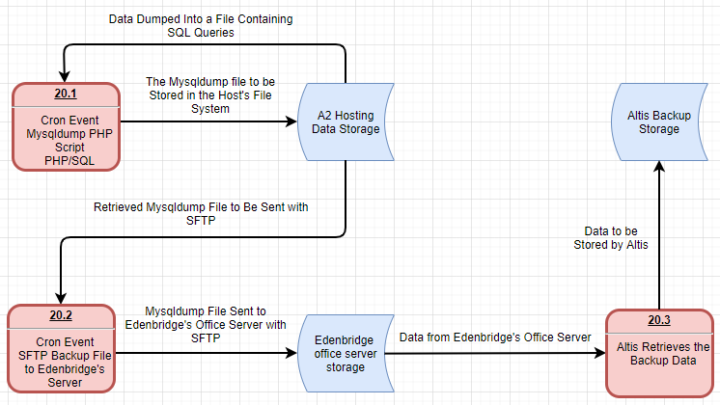
Notes:
Harley

Slide 31
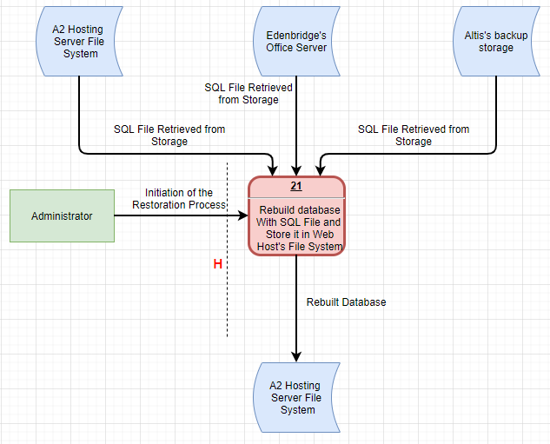
Notes:
Harley

Slide 32
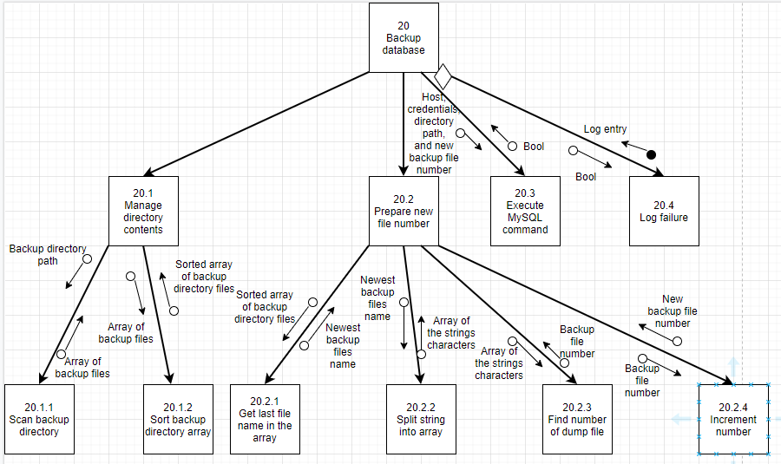
Notes:
Harley

Slide 33
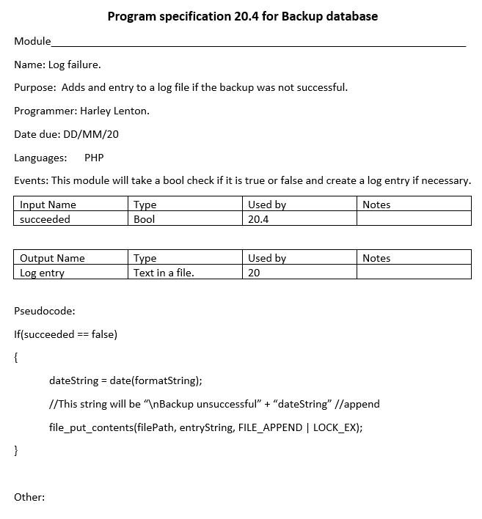
Notes:
Harley

Slide 34
Help items
There will be a help page with links to it available throughout the site.
Notes:
Harley

Slide 35
Physical Architecture
Manual/Automatic Processes
Data Distribution
Notes:
Beryon

Slide 36
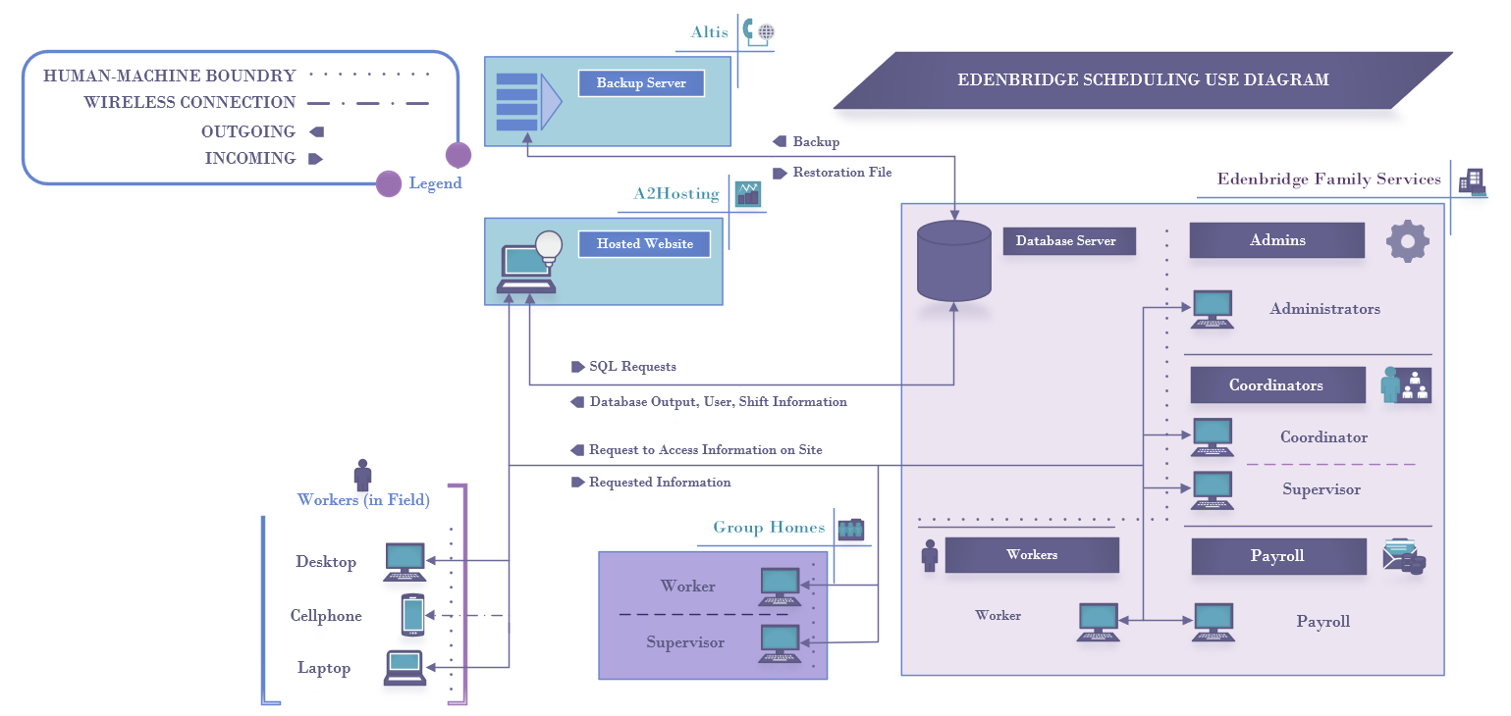
General Overview of Uses
Notes:
Beryon

Slide 37
Manual Processes
Process | Managed By | Reasoning
Timesheet Submission | Workers | Worker needs to confirm hours.
Shift Processes | Coordinators & Supervisors | Including the creation, rescheduling, and verification of shifts. Input needed to ensure best fit for job, manage scheduling/overtime conflicts.
User Creation & Management | Administrators | Security. Less chance of duplicate users.
Report Exporting | Payroll | Storage Only required reports output.
Notes:
Beryon

Slide 38
Required Hardware
System | Status | Description
Data Server | In Place | Handling data access and data storage logic. Located with Edenbridge physical location.
Web Server | In Place | Handling application logic with website. Located with A2Hosting.
Client Interface | In Place | Handling presentation logic, acting as primary interface. Options available in Edenbridge, available elsewhere.
Additional / Backup Storage | Optional Recommendions | Not required for system, different formats hold different benefits. Includes NAS (Networked Attached Storage) and RAID options.
Notes:
Beryon

Slide 39
Required Software
Application | Status | Description
MySQL | Procured | Database component, operational backbone. Community version easily implementable.
Apache | In Place | Web hosting component. Linux version, in use at A2Hosting.
PHP | In Place | Middleware. In place at A2Hosting
FPDF | Procured & Exportable | Report generating subset for PHP. Includable class.
PEAR | Investigating | PHP class library. Status dependant on installation required.
Notes:
Beryon

Slide 40




Client-Server architecture
Three tier architecture, with requirements set out as current configuration.
Client device handling presentation logic, at worker’s discretion.
Application logic handling underlying site and work; stored on and used by A2Hosting’s server.
Data storage & data access logic handled by Edenbridge’s server. Database stored on this server.
Notes:
Beryon

Slide 41
Data Distribution
Data distributed as required for a three-tier architecture.
General distribution as detailed in client-server architecture.
Additional distribution of backups:
Altis managing general backups.
A2Hosting managing database backup as well as website.
Notes:
Beryon

Slide 42
User Interface
Interface Mock-ups
Interface Flow
General Standards
Figma.com
Notes:
Aidan

Slide 43
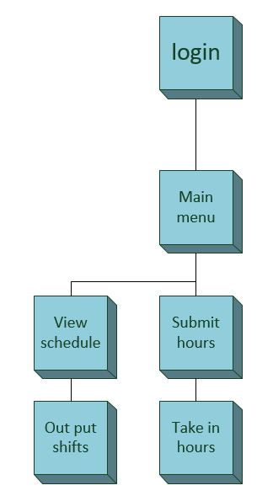
Worker view
Notes:
Aidan

Slide 44
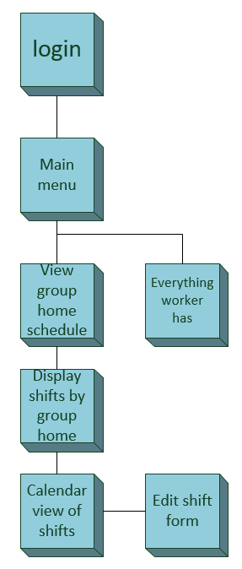
Supervisor view
Notes:
Aidan

Slide 45
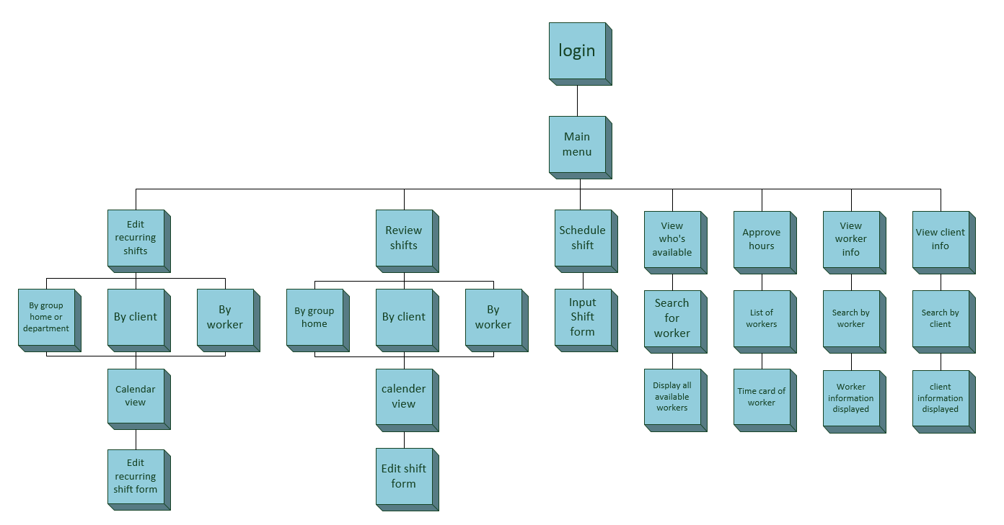
Coordinator view​
Notes:
Aidan

Slide 46
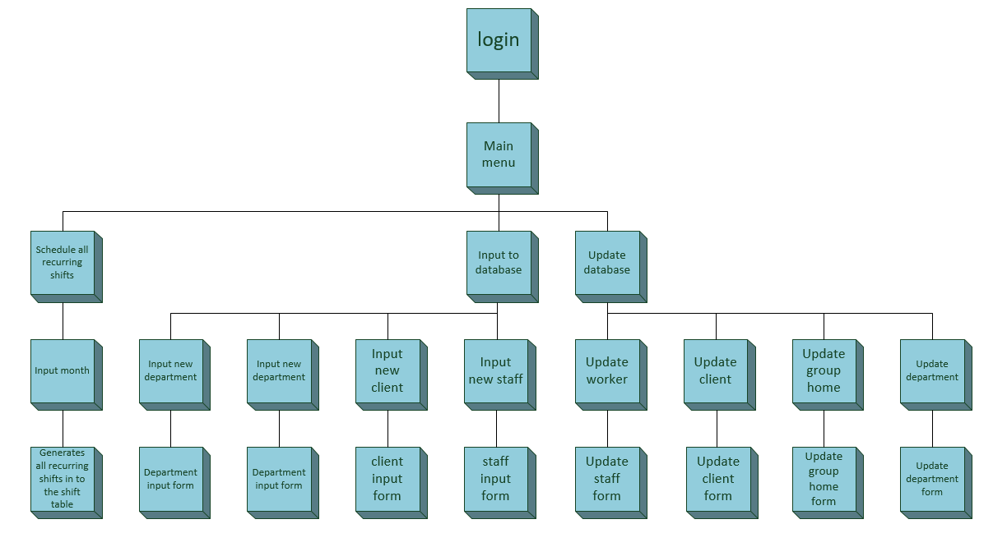
Coordinator view​ CONT.
Notes:
Aidan

Slide 47
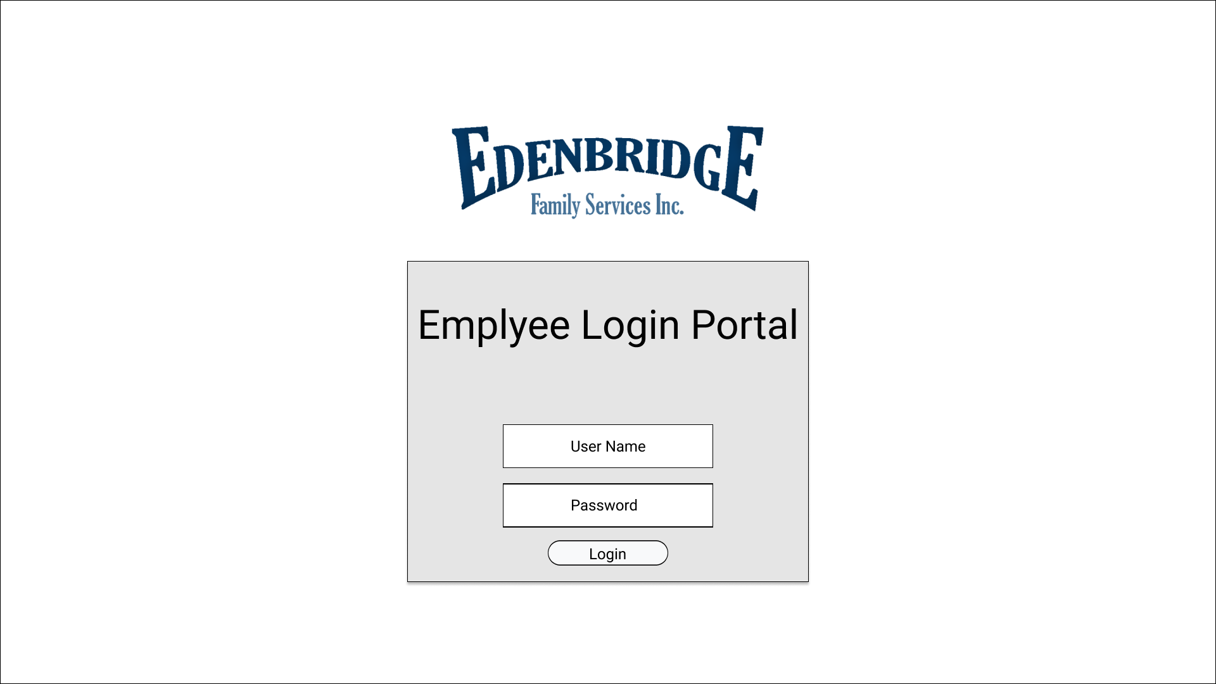
Notes:
Harley

Slide 48
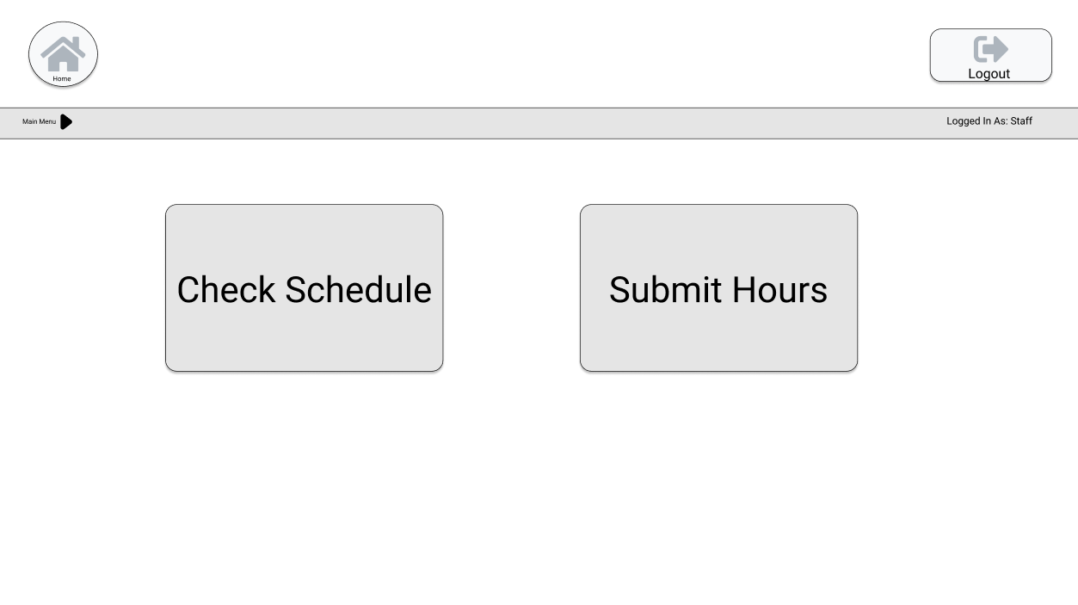
Notes:
Beryon

Slide 49
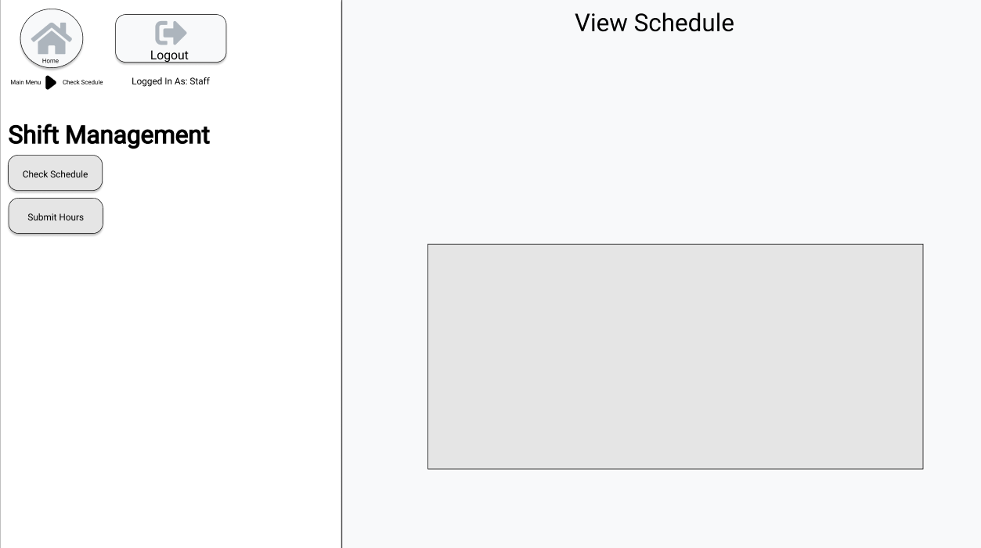
Notes:
Justin

Slide 50
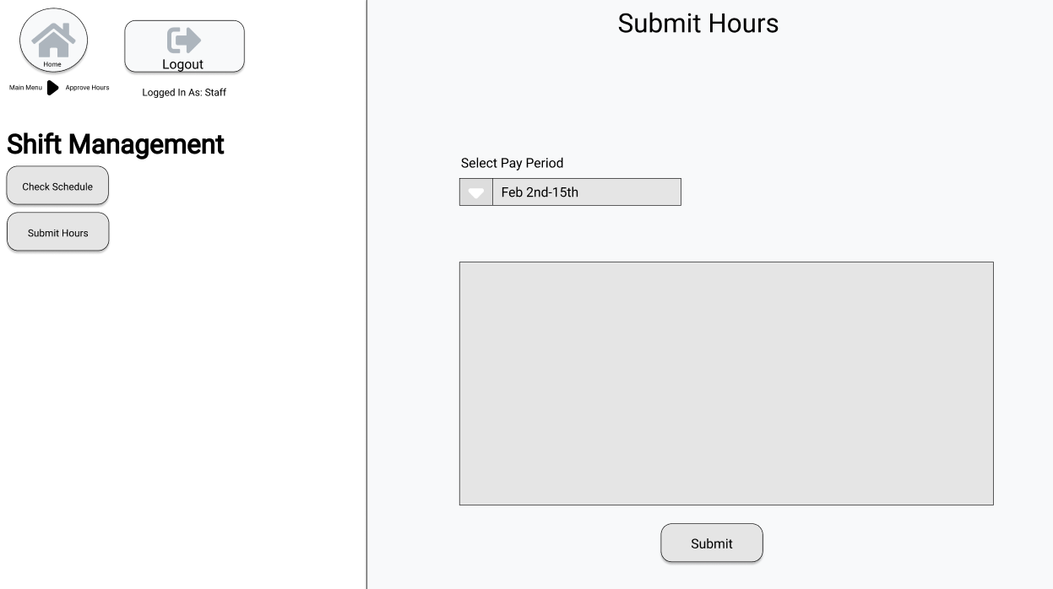
Notes:
Aidan

Slide 51
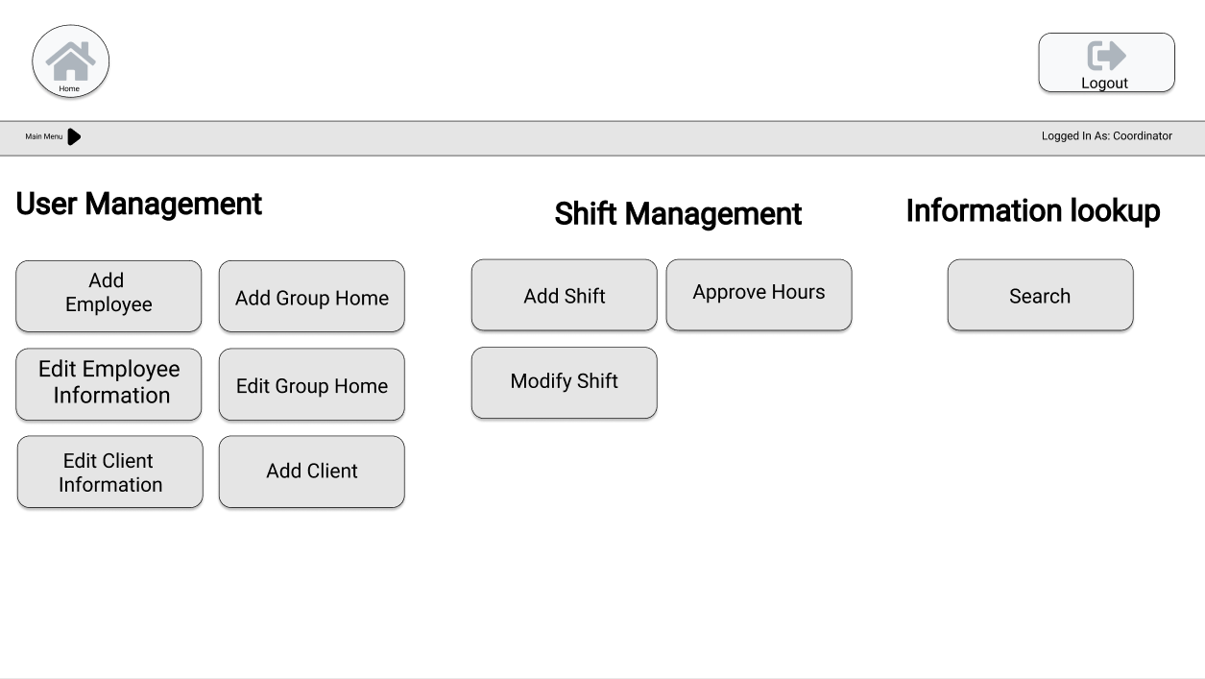
Notes:
Harley

Slide 52
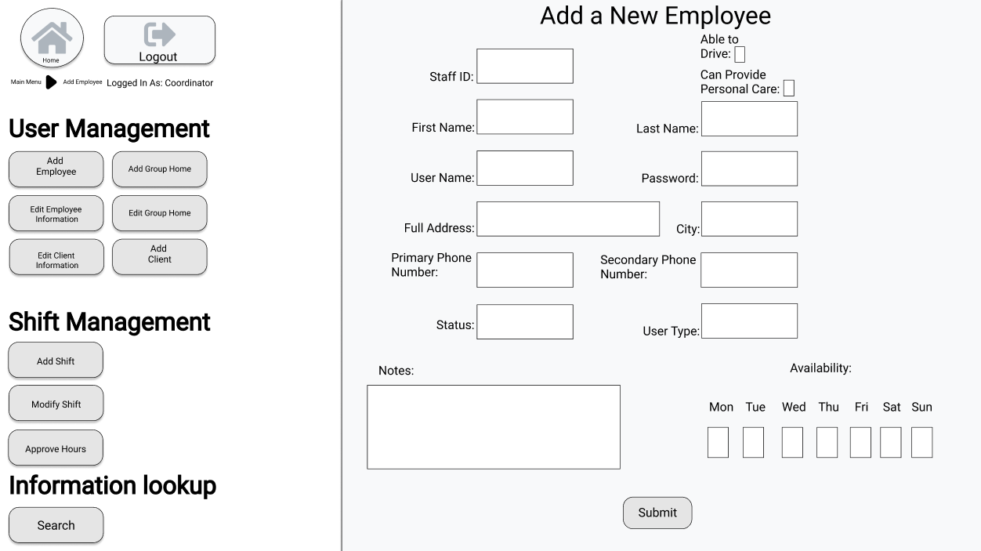
Notes:
Beryon

Slide 53
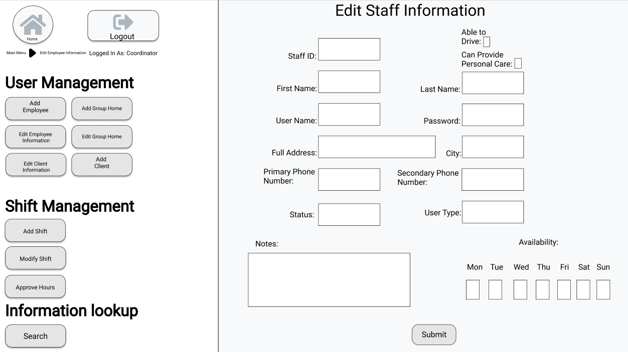
Notes:
Justin

Slide 54
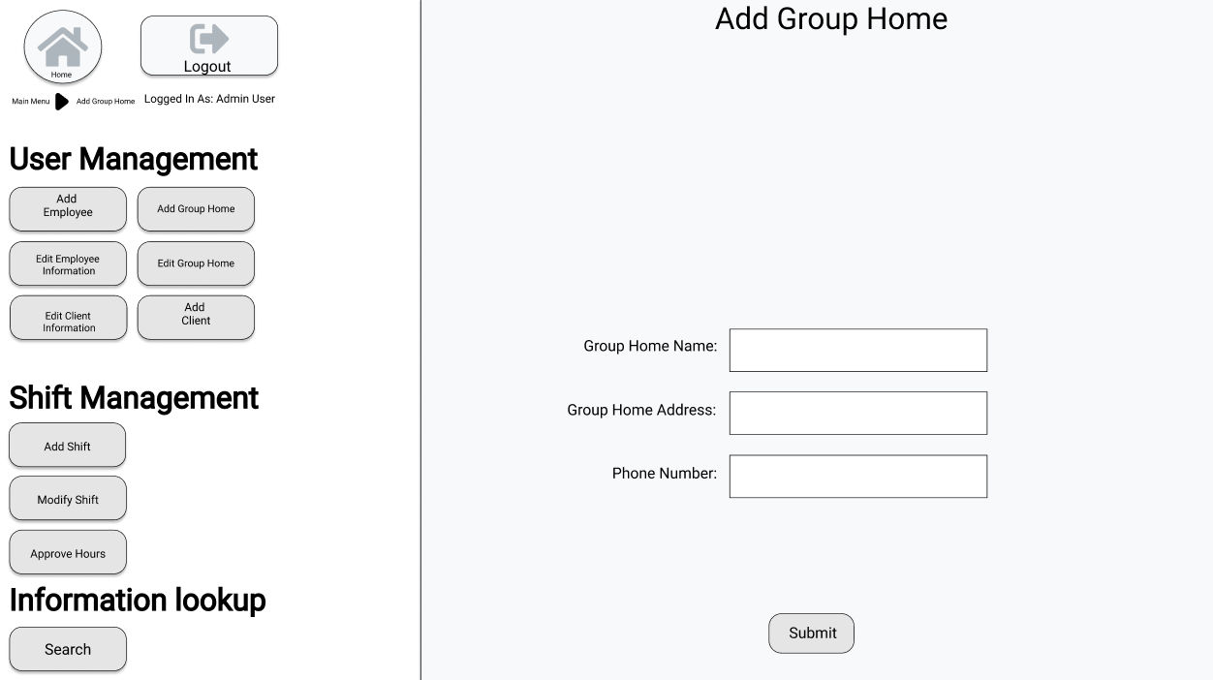
Notes:
Aidan

Slide 55

Notes:
Harley

Slide 56
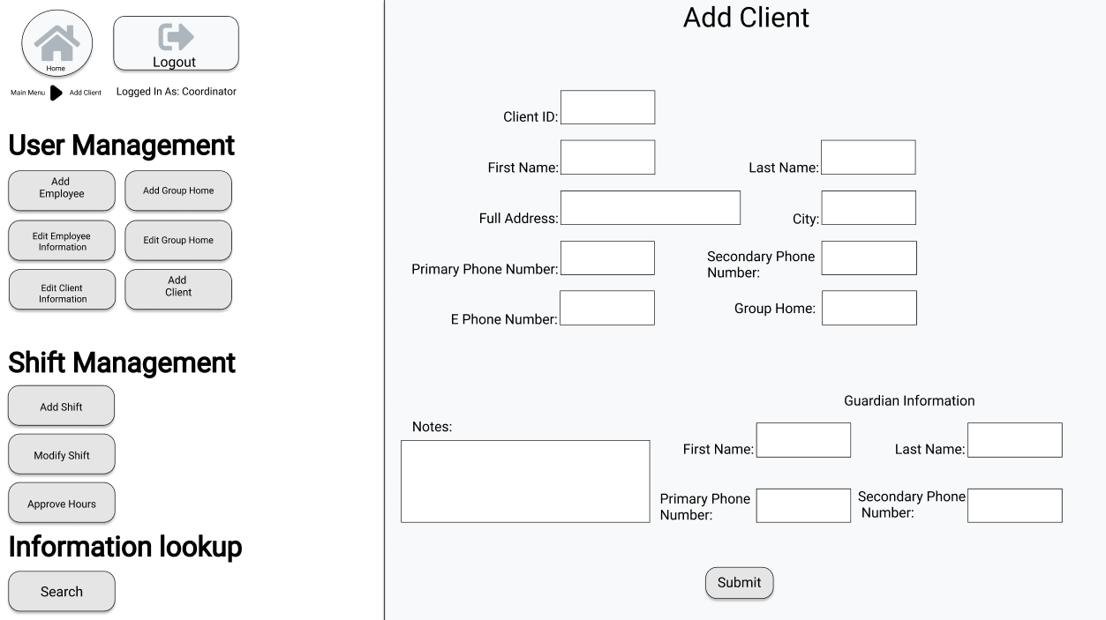
Notes:
Beryon

Slide 57
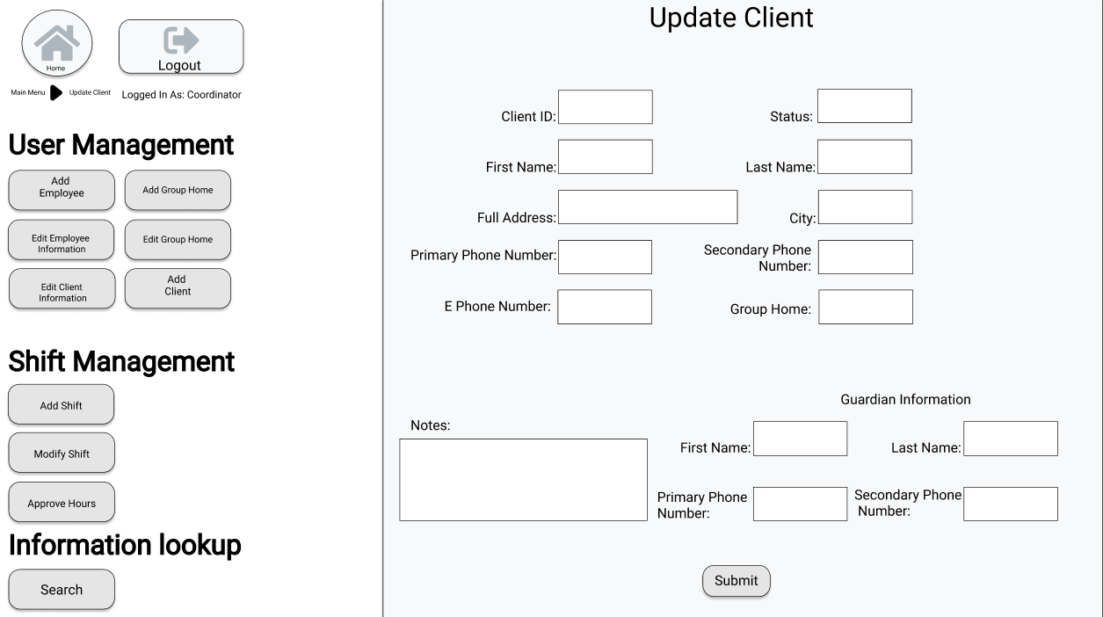
Notes:
Justin

Slide 58
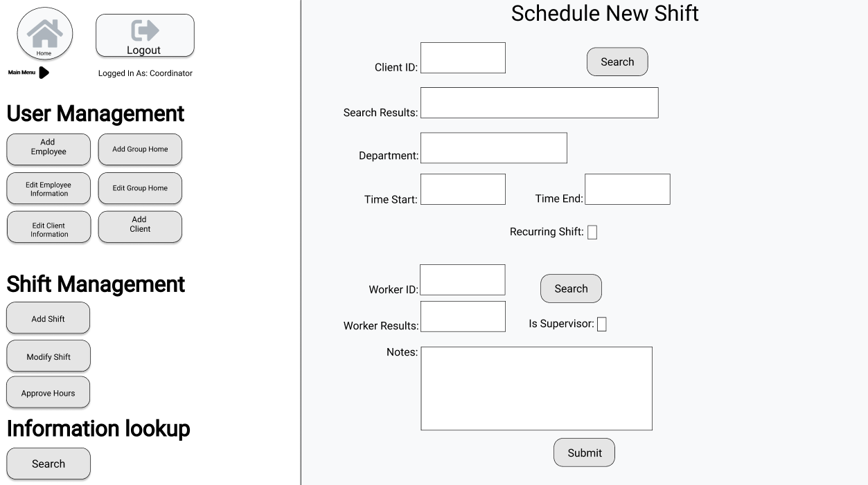
Notes:
Aidan

Slide 59
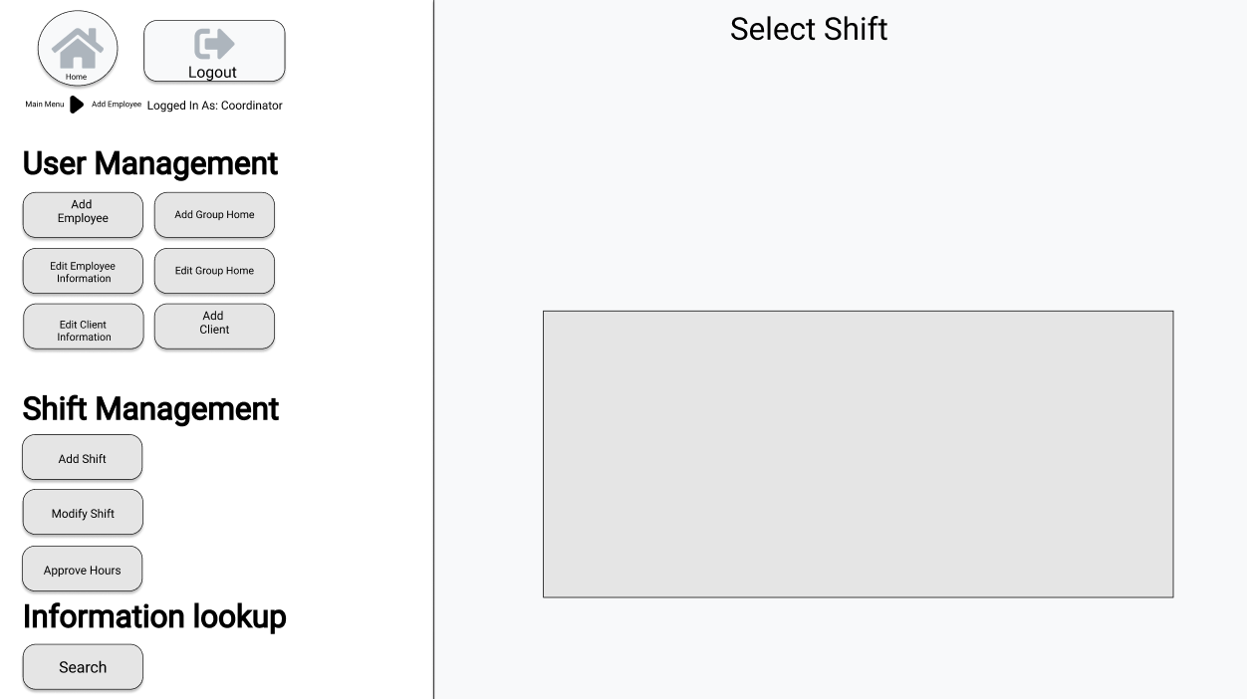
Notes:
Harley

Slide 60
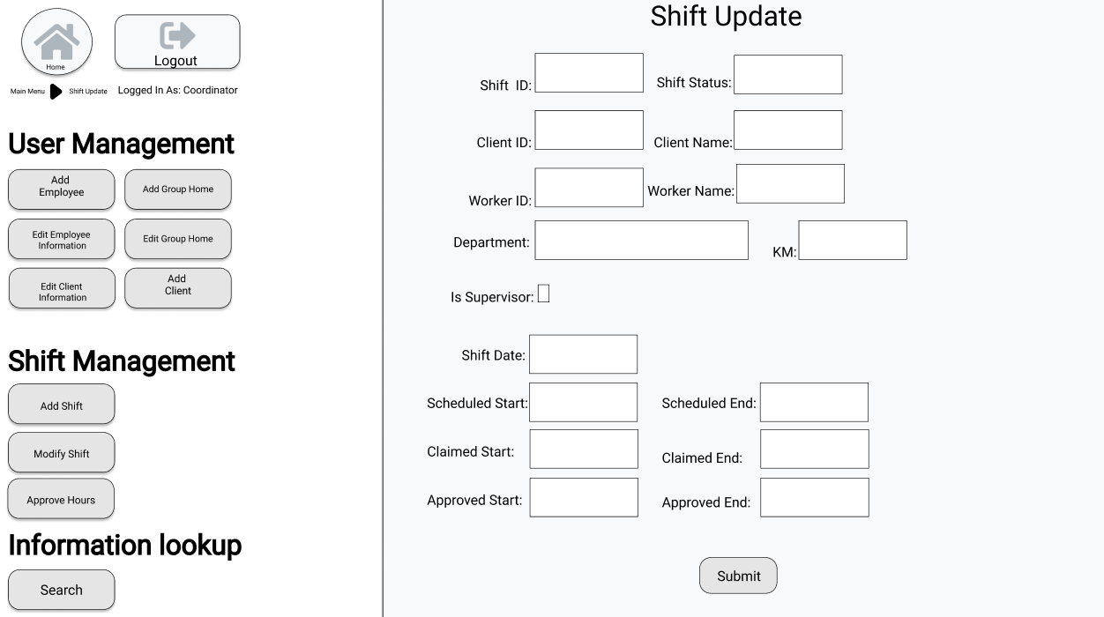
Notes:
Beryon

Slide 61
Conclusions
General Conclusions
Looking Forwards
Notes:
Beryon

Slide 62
Conclusion
Design phase save largely completed
Processes designed to assist in easing unneeded headaches
Structure designed with cohesion in mind
UIs designed for ease of use and transitioning of workflow
Notes:
Beryon

Slide 63
Looking Forwards
Next Month
Next Two Months
Beginning Implementation
Interface
Database
Testing of Components
Includes both internal testing and external
Continuous Testing
Finalization of Implementation
Establish Training Regimen
Includes testing of training for effectiveness
Delivery of System
Training of staff and other individuals
Notes:
Beryon

Slide 64
Questions?

